Slide 1
Instructor Materials Chapter 5: Windows Installation
IT Essentials v6.0
Notes:
Cisco Networking Academy Program
IT Essentials
Chapter 5: Windows Installation

Slide 2
Instructor Materials - Chapter 5 Planning Guide
This PowerPoint is divided in two parts:
Instructor Planning Guide
Information to help you become familiar with the chapter
Teaching aids
Instructor Class Presentation
Optional slides that you can use in the classroom
Begins on slide #11
Note: Remove the Planning Guide from this presentation before sharing with anyone.
Notes:
2

Slide 3
ITE 6.0 Planning Guide
Chapter 5: Windows Installation
Notes:
ITE 6.0 Planning Guide
Chapter 5: Windows Installation

Slide 4
Chapter 5: Activities
What activities are associated with this chapter?
Page Number | Activity Type | Activity Name
5.1.2.3 | Lab | Search NOC Certifications and Jobs
5.1.4.4 | Lab | Data Migration in Windows
5.2.1.3 | Interactive Activity (IA) | Identify Disk Terms
5.2.1.5 | Video | Disk Management
5.2.1.7 | Lab | Install Windows 8
5.2.1.7 | Lab | Install Windows 7
5.2.1.11 | Lab | Check for Updates in Windows 8
Notes:
4

Slide 5
Chapter 5: Activities (Cont.)
What activities are associated with this chapter?
Page Number | Activity Type | Activity Name
5.2.1.11 | Lab | Check for Updates in Windows 7 and Vista
5.2.2.8 | IA | Understand OS Installation Terms
5.2.3.2 | IA | List the Steps of the BIOS Boot Process
5.2.4.5 | Video | Disk Partitioning
5.2.4.6 | Video | Drive Mirroring
5.2.4.7 | Lab | Create a Partition in Windows 8
5.2.4.7 | Lab | Create a Partition in Windows 7 and Vista
Notes:
5

Slide 6
Chapter 5: Assessment
Students should complete Chapter 5, “Assessment” after completing Chapter 5.
Quizzes, labs, Packet Tracers and other activities can be used to informally assess student progress.
Notes:
6

Slide 7
Chapter 5: Best Practices
Prior to teaching Chapter 5, the instructor should:
Complete Chapter 5, “Assessment.”
The goal of this chapter is to understand the Windows installation process.
It is important to remember that different versions of Windows meet different customer requirements.
Make sure students understand disk preparation and partitioning. These are important topics related to Windows installation.
Make sure to dedicate some time to the different types of file sytems, especially NTFS and FAT variations.
Notes:
7

Slide 8
Chapter 5: Additional Help
For additional help with teaching strategies, including lesson plans, analogies for difficult concepts, and discussion topics, visit the ITE Community at community.netacad.net.
If you have lesson plans or resources that you would like to share, upload them to the ITE Community in order to help other instructors.
Notes:
8

Slide 9
Chapter 5: Topics in chapter that are not found in the CompTIA A+ 220-901 Certification
This slide lists content included in this chapter that is NOT listed in the CompTIA A+ 220-901 blueprint. Instructors could skip these sections; however, they should provide additional information and fundamental concepts to assist the student with the topic.
All content in Chapter 5 is aligned to the certification.
Notes:
9

Slide 10


Slide 11
Chapter 5: Windows Installation
IT Essentials v6.0
Notes:
Cisco Networking Academy Program
IT Essentials
Chapter 5: Windows Installation

Slide 12
Chapter 5 - Sections & Objectives
5.1 Modern Operating System
Explain operating system requirements.
5.2 Operating System Installation
Install a Microsoft Windows operating system.
5.3 Chapter Summary
Notes:
12

Slide 13
5.1 Modern Operating Systems
Notes:
Cisco Networking Academy Program
IT Essentials
Chapter 5: Windows Installation

Slide 14
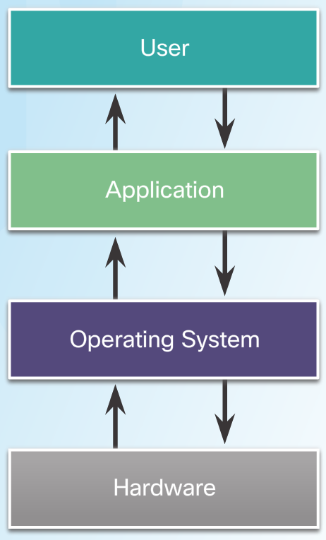
Modern Operating Systems Operating System Terms and Characteristics
Terms
Common terms describing operating systems include: multi-user, multitasking, multiprocessing and multithreading
Basic Functions of an Operating System (OS)
Hardware Access
File and Folder Management
User Interface (CLI and GUI)
Application Management
Processor Architecture
Affects the performance of the computer.
CPUs contain storage locations called registers.
Registers can be 32-bits or 64-bits long.
Notes:
5.1 - Modern Operating Systems
5.1.1 - Operating System Terms and Characteristics

Slide 15
Modern Operating Systems Types of Operating Systems
Desktop Operating Systems
Intended for use in SOHO environment.
Supports a single user.
Shares files and folders on a small network with limited security.
Microsoft Windows, Apple Mac OS, and Linux are a few examples.
Network Operating Systems
Contains features that increase functionality in a networked environment
Supports multiple users.
Provides increased security compared to desktop operating systems
Notes:
5.1 - Modern Operating Systems
5.1.2 - Types of Operating Systems

Slide 16
Modern Operating Systems Customer Requirements for an Operating System
OS Compatible Applications and Environments
Before recommending an OS, the technician must:
Review budget constraints.
Learn how the computer will be used.
Determine which types of applications will be installed.
Determine if a new computer needs to be purchased?
Minimum Hardware Requirements and Compatibility with the OS Platform
The OS minimum requirements must be met for optimal operation.
Some applications may also have specific hardware requirements.
Upgrades may be necessary.
RAM, hard drives, CPU, video card, motherboard are a few common upgradable components.
Microsoft Compatibility Center can be a good resource.
Notes:
5.1 - Modern Operating Systems
5.1.3 - Customer Requirements for an Operating System

Slide 17
Modern Operating Systems Operating Systems Upgrade
Checking OS Compatibility
New version of an OS brings new functionality and better performance.
Support for older hardware may be dropped.
New hardware may require latest OS versions.
Make sure to check OS compatibility before upgrading the OS.
Microsoft’s Upgrade Assistant and Upgrade Advisor can be helpful tools.
Windows OS Upgrades
Upgrading Windows may be faster than performing a full install.
The installed version of an OS determine the upgrades options.
A full data backup is strongly recommended before upgrading.
Data Migration
User data must be transferred after a new installation.
User State Migration Tool and Windows Easy Transfer are tools designed to help the transfer process.
Notes:
5.1 - Modern Operating Systems
5.1.4 - Operating Systems Upgrade

Slide 18
5.2 Operating System Installation
Notes:
Cisco Networking Academy Program
IT Essentials
Chapter 5: Windows Installation

Slide 19
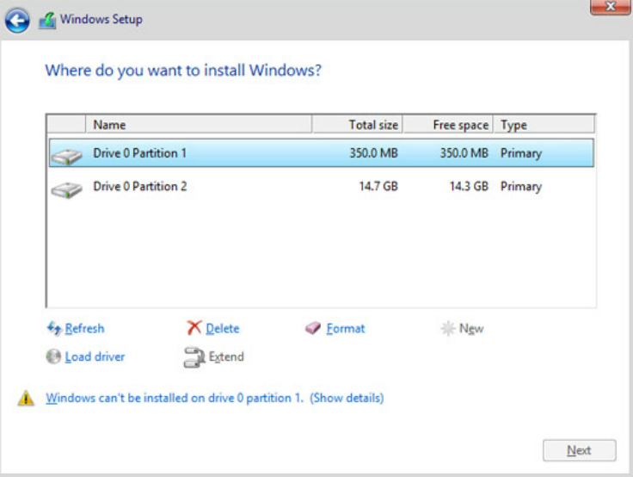
Operating System Installation Storage Device Setup Procedures
Storage Device Types
Hard Disk Drives
Flash Memory-Based Drives (USB Flash Drives, SSDs, SSHDs and eMMC)
Hard Drive Partitioning
Logical divisions inside a disk.
Proper partitioning is crucial for a correct boot process.
MBR and GPT are the two most popular partition scheme standards.
File Systems
File systems define how data is written
within a partition.
Different OSs, support different file systems.
FAT32, NTFS, exFAT, CCFS and NFS are
common file systems supported by
Windows-based OSs.
Notes:
5.2 - Operating System Installation
5.2.1 - Storage Device Setup Procedures

Slide 20
Operating System Installation Storage Device Setup Procedures (Cont.)
OS Installation with Default Settings
The installer program applies the most common settings.
Preferred by inexperienced users.
Allows for very little customization.
Windows allows for granular customization after the default setting installation is complete.
Account Creation
User accounts allow multiple users to share a computer.
Common Windows account types are Administrator, Standard, and Guest.
Finalize the Installation
Use Windows Update to check for updates after the
installation is complete.
Use Device Manager to verify that all hardware was
properly installed.
Notes:
5.2 - Operating System Installation
5.2.1 - Storage Device Setup Procedures (Cont.)

Slide 21
Operating System Installation Custom Installation Options
Disk Cloning
Good solution to speed up bulk installations
Uses a single OS installation as base system to create multiple clone systems.
Other Installation Methods
Windows has several different types of Custom Installations including network installation and image-based installation.
Other types of Custom Installations include Windows Advanced Startup Options, Refresh your PC (Windows 8.x only), System Restore, Upgrade, Repair installation, Remote network installation, Recovery partition, and Refresh/restore.
Network Installation
Relies on a network connection to deploy
the installation files.
Network Installation methods include
Remote Network Installation and Unattended Installation.
Notes:
5.2 - Operating System Installation
5.2.2 - Custom Installation Options

Slide 22
Operating System Installation Custom Installation Options (Cont.)
Restore, Refresh, and Recover
Some tools are also used to perform Custom Installations
These tools include Windows System Restore, Windows Refresh your PC, and Windows Recovery Partition.
System Recovery Options
Used to recover after a system failure.
Popular recovery tools are:
Windows Advanced Startup Options (Win 8.x)
System Recovery Options (Windows 7 & Vista)
Factory Recovery Partition
Notes:
5.2 - Operating System Installation
5.2.2 - Custom Installation Options (Cont.)

Slide 23
Operating System Installation Boot Sequence and Registry Files
Windows Boot Process
Common boot steps are: POST execution, locating and loading CMOS configurations, locating and loading bootloaders, locating and loading the OS.
Windows Boot Loader and Windows Boot Manager are programs used to manage Windows startup.
Startup Modes
Windows Startup Modes allow for troubleshooting when Windows fails to start.
Windows Startup Modes include: Safe Mode, Safe Mode with Networking, Safe Mode with Command Prompt and Last Known Good Configuration.
Windows Registry
All Windows settings are stored as key-values pairs in the Windows Registry
Extreme caution must be taken when working with the Registry.
Notes:
5.2 - Operating System Installation
5.2.3 - Boot Sequence and Registry Files

Slide 24
Operating System Installation Multiboot
Multiboot Procedures
It is possible to install multiple OSs in one computer.
BOOTMGR manages multiple versions of Windows installed on a single computer.
Disk Management Utility
Many tasks can be accomplished through Disk Management Utility, including: view drive status, extend partitions, split partitions, assign drive letters, add drives and add arrays.
Partitions
Logical divisions created inside a drive to host file systems.
Partitions can be extended or shrunk using the Disk Management Utility
Drive Mapping or Drive Letter Assignment
In Windows, assigning letters to name physical or logical drives is called drive mapping or drive letter assignment.
Disk Management Utility can also be used to manage drive letter assignment.
Notes:
5.2 - Operating System Installation
5.2.4 - Multiboot

Slide 25
Operating System Installation Disk Directories
Directory Structures
Designed to store files and folders.
A disk must be initialized and formatted if Windows cannot recognize its file systems.
Formatting a disk or partition creates a file system.
Formatted disks or partitions must be mounted before use.
User and System File Locations
System files are files critical to the OS operation.
User files are files belonging to a user and of little significance to the OS.
Notes:
5.2 - Operating System Installation
5.2.5 - Disk Directories

Slide 26
Operating System Installation Disk Directories (Cont.)
Attributes
File extensions identify file types in Windows and must adhere to Windows Naming Convention.
File attributes define how files can be handled.
Common file attributes are READ, ARCHIVE, SYSTEM and HIDDEN.
Application, File, and Folder Properties
Right-click on a file, application or folder to see its properties.
Application and File Properties are different than Folder Properties.
Notes:
5.2 - Operating System Installation
5.2.5 - Disk Directories (Cont.)

Slide 27
5.3 Chapter Summary
Notes:
Cisco Networking Academy Program
IT Essentials
Chapter 5: Windows Installation

Slide 28
Chapter Summary Summary
This chapter introduced computer operating systems. As a technician, you should be skilled at installing Windows® operating systems. The following concepts from this chapter are important to remember:
Several different operating systems are available, and you must consider the customer’s needs and environment when choosing an OS.
The main steps in setting up a customer’s computer include preparing the drive, installing the OS, creating user accounts, and configuring installation options.
Notes:
2.3.1.1 - Summary

Slide 30
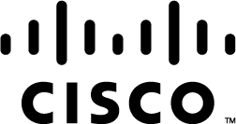

Slide 31
Chapter 5 New Terms and Commands
aero
bootmgr
bootrec
charms
directx
diskmgmt
dll
docx
emmc
exe
exfat
fat32
gpt
hkey
java
mbr
mulitiboot
nfs
nos
ntfs
ntoskrnl
opengl
opentype
pnc
pnp
pptx
pxe
soho
ssd
sysprep
system32
truetype
userprofile
usmt
wim
winload
winlogon
winre
Notes:
New Terms and Commands

